Slide 1

ACADEMIC PROJECT MANAGEMENT SYSTEM
PROJECT NO:36
Team No. 108

Slide 2
TEAM MEMBERS: GANDI VISHNU PRIYA – 2000030299 GAYATHRI SADHINENI – 2000030306 (LEAD) SASI PRIYANKA JAMPANI – 2000030914
.

Slide 3
PROBLEM STATEMENT
In this project there will be three major users:
a. Students
b. Mentor
c. Administrator
Administrator will have access to all three modules. Students will form groups and then they will be allocated projects and mentor accordingly. Mentor will assign tasks to students based on their projects and they will track the progress of projects.

Slide 4
MODULES:
Student
Mentor
Administrator

Slide 5
SUBMODULES IN STUDENT MODULE:
Project selection tab
View tab to show details like team members, problem statement of the project.
Groups tab to display all the groups along with group id, group name.
SUBMODULES IN MENTOR MODULE:
Home tab to redirect to home page.
View details tab to display the groups, problem statements and status of the project till now.
Task assignment tab to assign tasks to students based on their projects.
SUBMODULES IN ADMIN MODULE:
Student registration tab for registering students to a particular project.
Mentor registration tab for registering mentors to projects.
View tab to display project details like allocated group and mentor, problem statements, students list, mentors list.

Slide 6
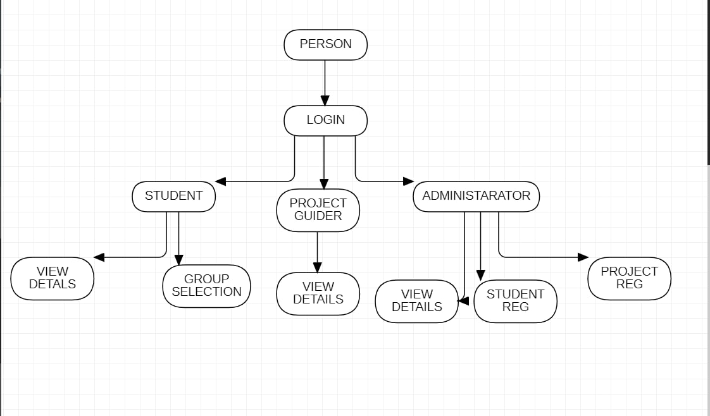

Slide 7
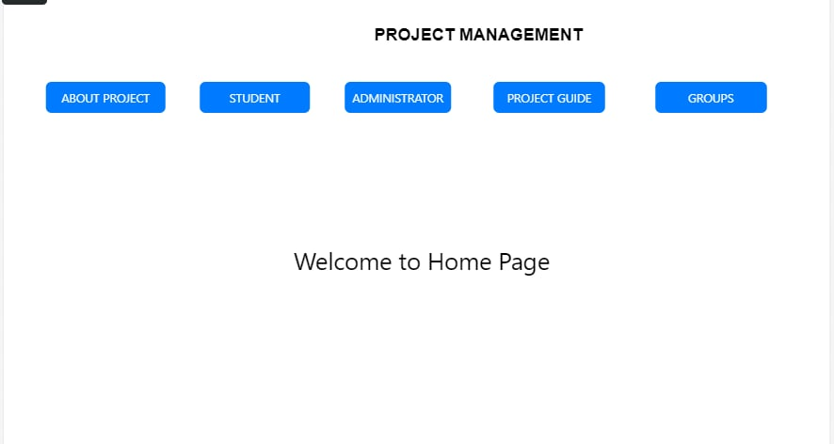

Slide 8
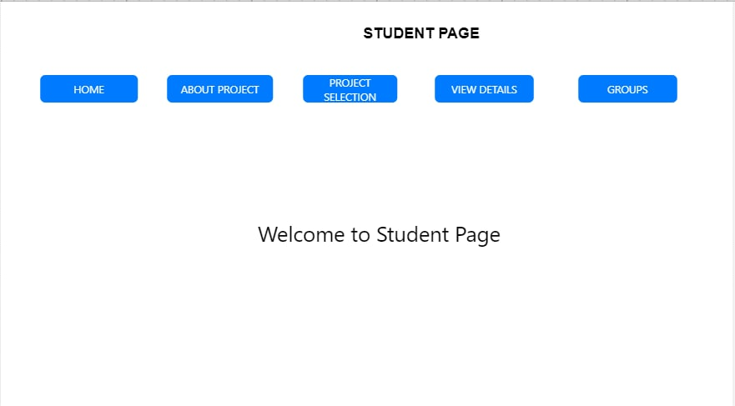

Slide 9
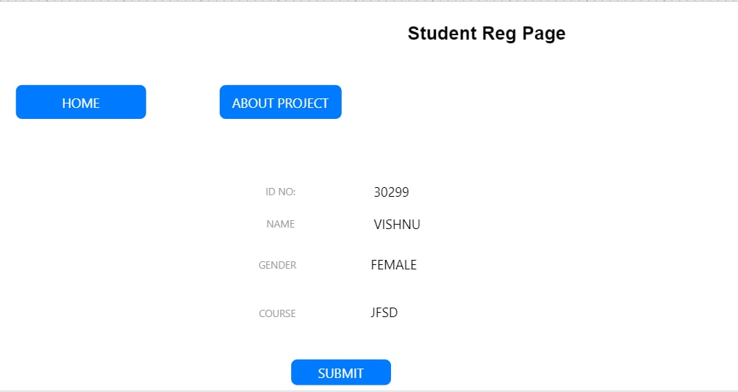

Slide 10
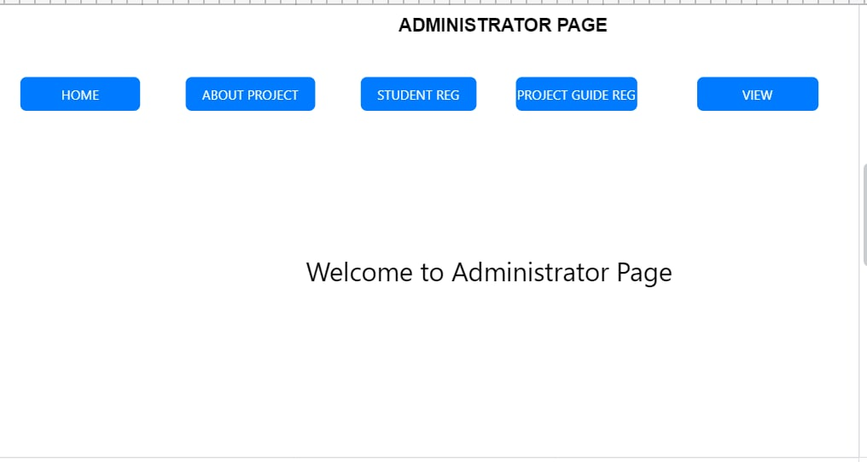

Slide 11
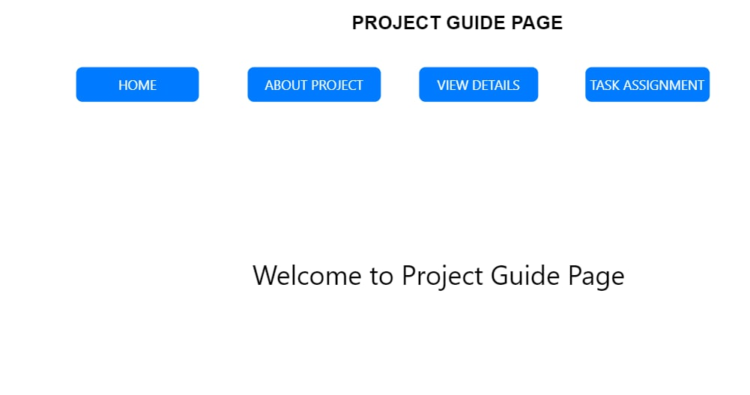

Slide 12
Thank You

